Slide 2
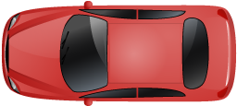






$$d_{lat}$$
$$v_{actor}$$
$$d_{long}$$
$$α$$
$$θ$$
$$v_{long}$$

Slide 3






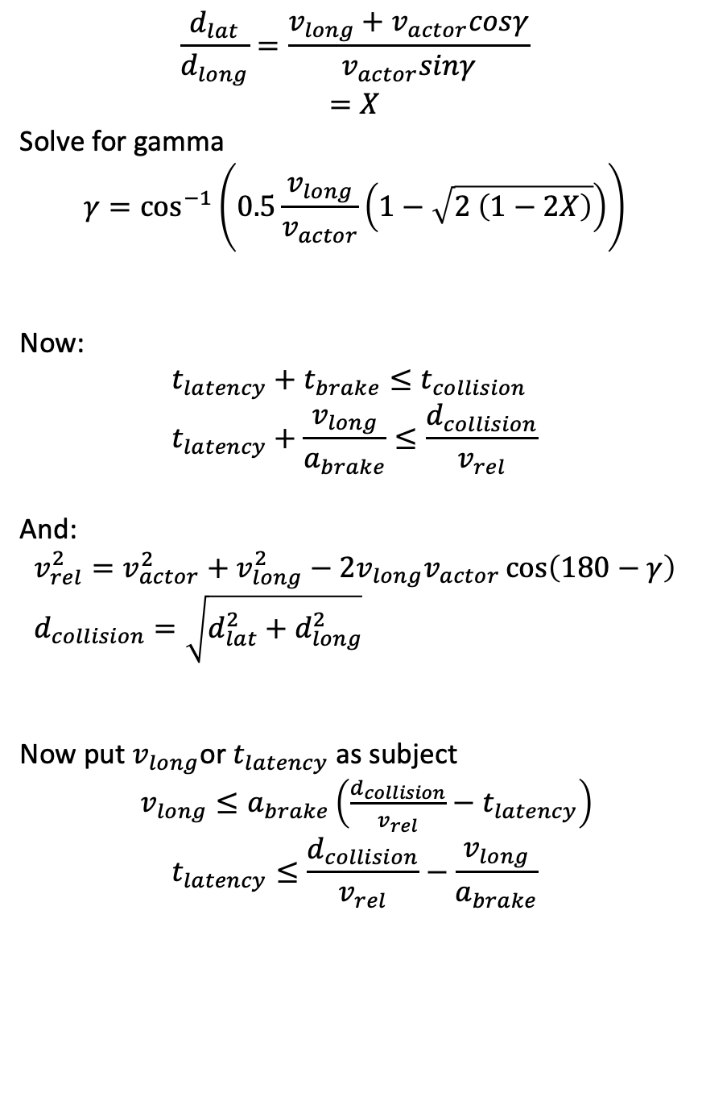
$$\frac{d_{lat}}{d_{long}}=\frac{v_{long}+v_{actor}cosγ}{v_{actor}sinγ}$$
$$=X$$
Solve for gamma
$$γ=\cos^{−1}\left(0.5\frac{v_{long}}{v_{actor}}\left(1−\sqrt{2 \left(1−2X\right)}\right)\right)$$
Now:
$$t_{latency}+t_{brake}≤t_{collision} \\ t_{latency}+\frac{v_{long}}{a_{brake}}≤\frac{d_{collision}}{v_{rel}}$$
And:
$$v_{rel}^{2}=v_{actor}^{2}+v_{long}^{2}−2v_{long}v_{actor}\cos\left(180−γ\right) \\ d_{collision}=\sqrt{d_{lat}^{2}+d_{long}^{2}}$$
Now put $v_{long}$or $t_{latency}$ as subject
$v_{long}≤a_{brake}\left(\frac{d_{collision}}{v_{rel}}−t_{latency}\right)$ $$t_{latency}≤\frac{d_{collision}}{v_{rel}}−\frac{v_{long}}{a_{brake}}$$
$$d_{lat}$$
$$θ$$
$$d_{long}$$
$${−v}_{long}$$
$$v_{rel}$$
$$γ$$
$$v_{actor}$$

